Slide 1
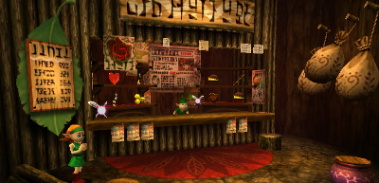
Welcome to the Deku Store
by Nishad Prinja

Slide 2
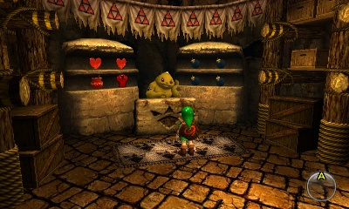
Project Requirements
- Application has to do CRUD functions.
- There must be at least 3 tables/collections
- Must use MySQL or MongoDB
- Create ERD to show all tables
- There must be a login feature
- Have user/admin roles
- Logging of events and DB functions implemented

Slide 3
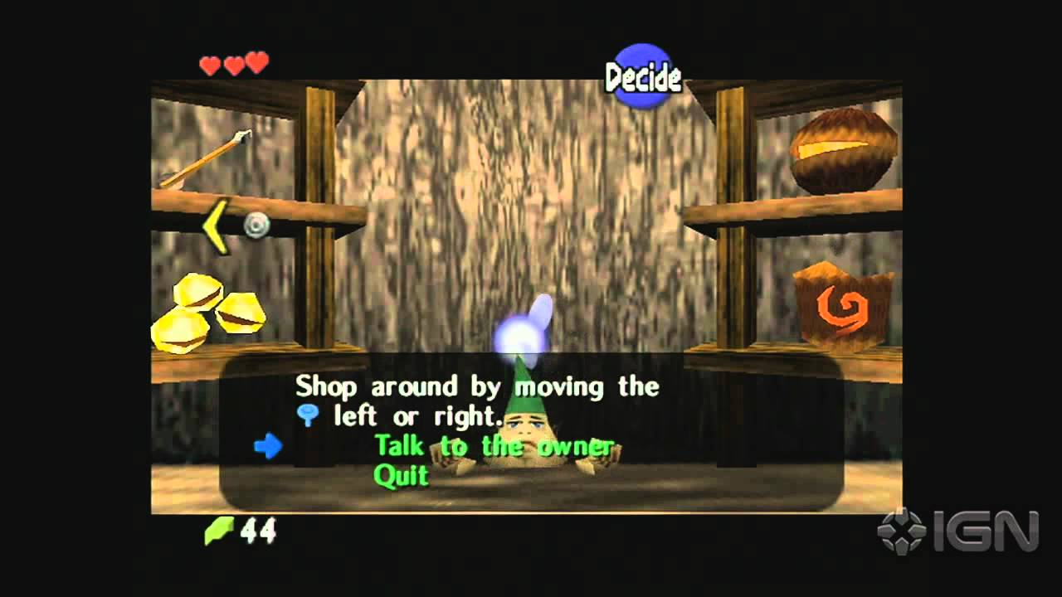
Project Description
- A Deku Store that sells items like the shops in Legend of Zelda: Ocarina of Time
- Customers can buy and sell items in the store
- Customers can scavenge for rupees to add to their wallet
- Can break pots, cut grass, or kill enemies similar mechanics to LoZ: OoT
- Admin users can modify user details and add/edit the Deku Shop inventory
- Logging takes place after each event in the program, especially dB operations

Slide 4
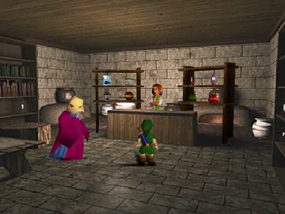
Tech Stack
- Python 3.13.0
- MongoDB
- Visual Studio Code
- Git/Github

Slide 5
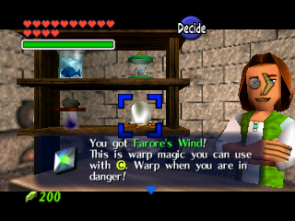
DEMO

